Slide 1
Gender differences in vascular ultrasound in prevention, treatment and prognosis of ischemic stroke: does gender matter in ultrasound?
Christine Kremer, associate professor Department of Neurology Skåne University Hospital Malmö/Lund, Department Clinical Sciences Lund University, Sweden
ESNCH conference 16 th Oct 2021

Slide 2
Why are gender differences in ultrasound important? Precision medicine?
Stroke prevention – Stroke etiology
Risk factors in women, modifiable, non-modifiable, at what age?
Acute stroke treatment -
Outcome, Recurrency, prognosis?

Slide 3
Do we need to screen women and men differently?
Pro
more individualized approach
Con
Avoid bias
Avoid generalization
Sex-specific treatment?

Slide 5
Mortality stroke projected numbers of deaths
Reeves, J,Bushnell, C
Lancet Neurology 2008. 10: 915-926.
Projected number of deaths from stroke among whites (USA, 2000–2050)

Slide 6
Example - Presentation and admission
Higher percentage of non-traditional stroke symptoms ¹
More stroke mimics ²
Treatment delay ³
¹Bushnell et al Lancet Neurology 2018, 17: 641-65; ² Yu et al Neurology 2021;96(5):e732-e739. ³ Mainz et al Stroke 2020 Aug;51:2332-2338

Slide 7
Sex differences prevention and treatment
Primary prevention ASA - ASA may be more effective
Intravenous thrombolysis- higher mortality- lower rate of independence
Endovascular therapy - lower rate of independence
Stroke prevention in atrial fibrillation - lower mortality in women treatment with DOAC
Kremer et al. Sex differences in prevention and acute treatment of ischemic stroke- a systematic review
and meta-analyses, unpublished, under review

Slide 8
Ischemic Stroke etiology age - dependent
Older
Cardioembolic
Large artery atherosclerosis
Lacunar
Younger pregnancy- related- hormonal therapy
Cardioembolic
Large artery atherosclerosis
Unknown embolic source
Venous stroke
Sex Differences in First-Ever Acute Stroke
Roquer et al Stroke. 2003;34:1581-1585.

Slide 9
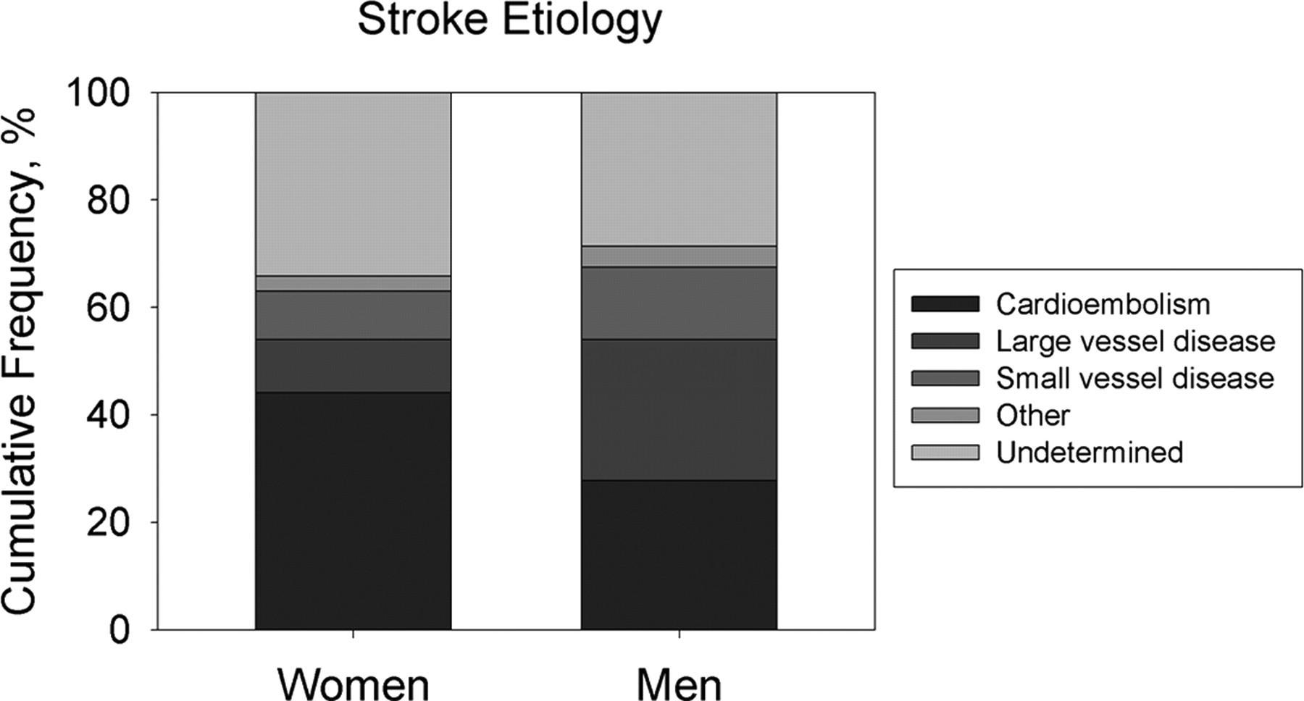
Alex Förster et al. Stroke. 2009;40:2428-2432
Copyright © American Heart Association, Inc. All rights reserved.
Notes:
Figure 2. Cumulative frequency of stroke etiology in women and men with AIS.

Slide 10
Women anterior vs. posterior circulation strokes
Anterior circulation stroke (embolic)
Women > men
Posterior circulation stroke(embolic/lacunar)
Men > women
Frid et al J Neurol. 2020 Mar;267(3):649-658

Slide 11
Large artery atherosclerosis
More men show large artery atherosclerosis
Sex differences in plaque composition ¹
Sex differences in outcome after carotid endarterectomy /stenting ²
¹ Song et al J AmHeart Assoc2021 May 4 10(9)
² Howard V et al Stroke. 2021 Jan;52(2):416-423

Slide 12
Implications for vascular ultrasound
Follow-ups carotid ultrasound? Active atherosclerosis-unstable plaque?
Aortic plaques?
Additional examinations: MRI neck/microembolization?

Slide 13
Cardiac embolic source
.
.
Women with atrial fibrillation have a higher stroke risk
Different anatomy? Atrial diameter?
Aortic plaque?
Ex: sex-differences in survival with dilatative cardiomyopathy ¹
¹ Cannata A Can J Cardiolog 2020 Jan;36(1):37-44.

Slide 14
Implications for ultrasound
Cardiac ultrasound examinations and follow-up
Additional measurements
Aortic plaque?

Slide 15
Younger vs. older women vs. men
Hormonal (estrogen) therapy - dose-dependant ¹(smoking/migraine)
Cerebral venous thrombosis – Puerperium - obesity, hormonal therapy ²
Migraine with aura - migraineous stroke? ³ (posterior circulation)
Reversible vasoconstriction syndrome (SAH/Stroke)
¹Roach RE et al Cochrane Database of Systematic Reviews 2015;²Zuurbier S et al JAMA Neurol. 2016 May 1;73(5):579-84. ³ K. Laurell et al Eur J Neurol 2011;18: 1220–1226; Anne Ducros et al. Brain 2007, 130: 3091-3101.

Slide 16
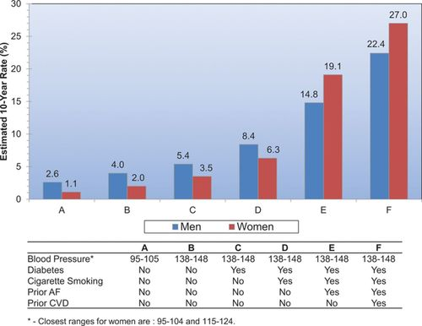
Stroke risk and co-morbidities
© 2015 American Heart Association, Inc.
Dariush Mozaffarian. Circulation. Heart Disease and Stroke Statistics—2016 Update; 133, e38-e360

Slide 17
Risk factors not-modifiable
Pregnancy, post-partum
Migraine w/ aura
Atrial fibrillation
Post-menopausal - Hormonal replacement therapy

Slide 18
Stroke risk factors - modifiable
Blood pressure
Diabetes
Metabolic syndrome
Dyslipedemia
Smoking
Madsen et al, Focused update- Impact of conventional risk factors on stroke in women: an update Stroke 2018; 49, 3 : 536-542

Slide 19
Sex Differences in Risk Factor Prevalence, Associations, and Treatment Disparities, Women Compared With Men
Risk Factor | Prevalence | Association With IS | Treatment Disparity
Hypertension | Lower in women (vs men) in younger age groups, higher in older age groups | Similar in women (vs men) in younger age groups, higher in older age groups | In younger age groups, women more likely to have BP controlled; in older age groups, women less likely to have BP controlled
Dyslipidemia | Data conflict; either similar between sexes or lower in women | Lower in women | Women less likely to be on statins and have LDL controlled
Atrial fibrillation | Higher in women | Higher in women | Women less likely to be prescribed oral anticoagulants, less likely to have cardiac ablation, and receive lower doses of NOACs
Migraine | Higher in women | Higher in women | Unknown if migraine treatment reduces stroke risk
Diabetes mellitus | Similar women vs men | Higher in women | Data conflict on sex differences in meeting HbA1c goal
Cognitive impairment | Higher in women | Unknown whether there is a sex difference | Women less likely to be treated with antidementia drugs
Madsen et al, Focused update- Impact of conventional risk factors on stroke in women: an update
Stroke 2018; 49, 3 : 536-542

Slide 20
Help - she´s pregnant !

Slide 21
Pregnancy Stroke Risk
Eclampsia, Pre-Eclampsia (8- 10% pregnancies¹)
Posterior reversible encephalopathy syndrome (PRES)
Reversible cerebral vasoconstriction syndrome (Postpartum)
Cerebral venous thrombosis (Postpartum)

Slide 22
Ultrasounds role in stroke in pregnancy
Non-invasive, non contrast, no radiation
ex Monitoring PRES/RVCS, CVT?

Slide 23
Prognosis - Outcome
Post-stroke depression
Cognitive impairment
Age
Social factors, loneliness
„unhappiness stroke“?
Stress and vascular disease?
Gall S et al : Focused update in Patient Reported Outcome measures Stroke 2018;49:531–53

Slide 24
Outcome - Stroke Recurrency
More severe strokes
Higher recurrency stroke - atrial fibrillation ¹
Less aggressive treatment in women (side effects drugs/frailty?)
„Underscreened“ ?
¹ Hong Y et al. Front Neurol.2017;8: 166

Slide 25
Lack of Evidence
Underrepresentation of women in randomized clinical trials ¹
Exclusion of older women
Lack of sex –specific analysis ²
¹ Tsivgoulis et al Ther Adv Neurol Disord. 2017;10(5):241-4.; ² Carcel et al Int J Stroke. 2019 Dec;14(9):931-938.

Slide 26
Future Directions
Sex as a variable prospectively ¹
Sex-specific analysis (ex carotid endartectomy/stenting)
Include females of all ages into trials
Risk factors – screening- prevention- follow-up
¹ Azarpazhooh M et al Assess study J neurol sciences 2019;399:209-213

Slide 27
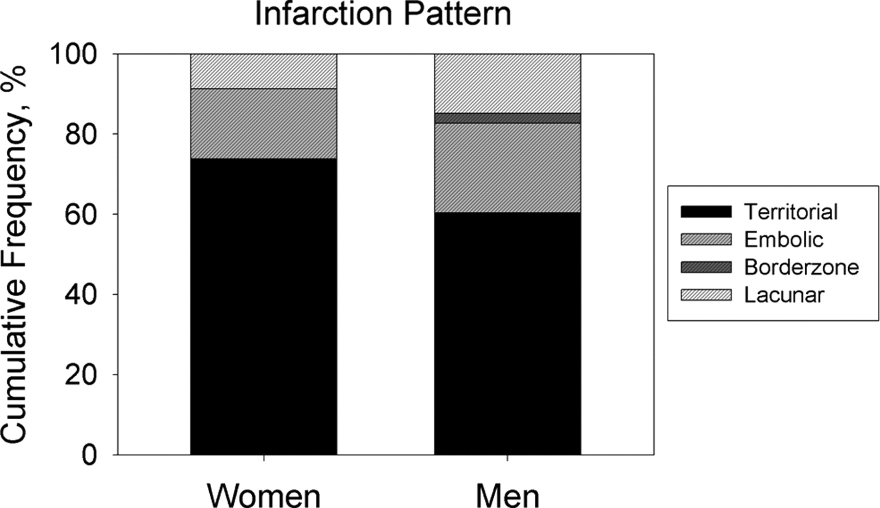
Type of stroke
Alex Förster et al. Stroke. 2009;40:2428-2432
Copyright © American Heart Association, Inc. All rights reserved.
Notes:
Figure 3. Cumulative frequency of different infarction patterns in women and men with AIS.

Slide 28
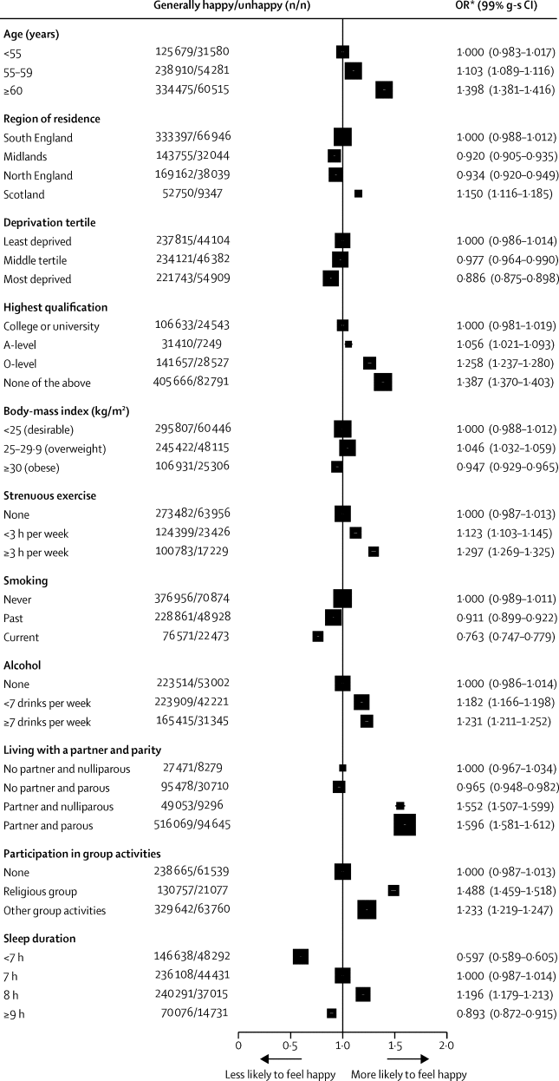
Does happiness itself directly affect mortality? The prospective UK Million Women Study
COVID?

Slide 29
Does gender matter in ultrasound?
Yes for a more individualized approach-but not for sex specific basic algorithms in prevention and treatment of ischemic stroke

Slide 30
Thank you for your attention!

